Slide 1

ADVENTURE WORKS
Group-2

Slide 2
Group Members-Group 2
Richa Jemadevi
Sayali Nawanit
Sanket Karane
Annapoorneshwari.S
Anjali Nema
Shubam Nema
Rohit

Slide 3

INTRODUCTION
ADVENTURE WORKS
Adventure Works Cycles, the company on which the Adventure Works sample databases are based, is a large, multinational manufacturing company. The company manufactures and sells metal and composite bicycles to North American, European and Asian commercial markets. While its base operation is in Bothell, Washington with 290 employees, several regional sales teams are located throughout their market base.
In 2000s, Adventure Works Cycles bought a small manufacturing plant in Mexico. Which manufactures several critical subcomponents for the Adventure Works Cycles product line. These subcomponents are shipped to the Bothell location for final product assembly. In 2001, this manufacturing plant became the sole manufacturer and distributor of the touring bicycle product group.
Coming off a successful fiscal year, Adventure Works Cycles is looking to broaden its market share by targeting their sales to their best customers, extending their product availability through an external Web site, and reducing their cost of sales through lower production costs.

Slide 4

Modules
We perform this project in 4 modules :-
Excel
Tableau
Power Bi
SQL

Slide 5
Excel
We receive our dataset in excel sheet. It contain all information related to Adventure Works.
By using our main data, we create three more table.

Slide 6
Excel Dashboard
Sales Overview: This Excel sheet presents a high-level sales overview for Adventure-Work, including a total sales figure of ₹96,06,281. The data is further analyzed to provide insights into quarterly, yearly, and monthly sales.
Quarter Wise Sales Analysis: Explore the quarterly sales trends for Adventure-Work in this section. Understand how sales performance varies across different quarters, possibly highlighting peak seasons or trends.
Year Wise Sales Breakdown: Gain insights into the annual sales performance of Adventure-Work. Visualize the sales data year by year to identify long-term growth or fluctuations.
Sales vs. Production Costs: Analyze the relationship between sales amounts and production costs to assess profit margins and cost-effectiveness. This section provides valuable insights into the company's financial performance.

Slide 7
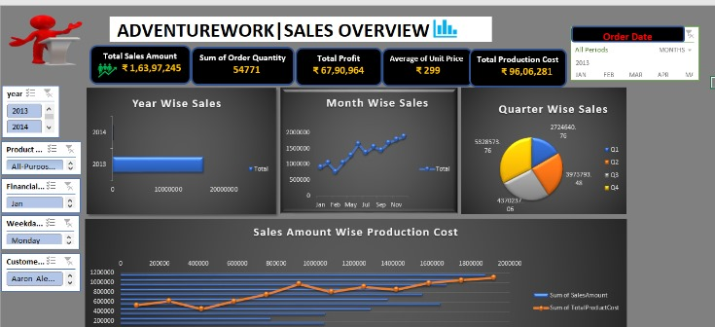

Slide 8
Challenges Faced
Converting date type
1
Adjusting relation
2
Plotting some graphs
3

Slide 9

Tableau
In Tableau, our initial step involves importing our primary Excel dataset, which contains all the necessary tables. While this process initially posed some challenges, we were able to overcome them successfully.
Once we've imported all the tables into Tableau, our next step is to establish relationships between them. This involves defining how the tables are interconnected and interact with each other within the data model.
Data Connection: To start building a model in Tableau, you first need to connect to your data source. Tableau supports a wide range of data sources, including databases, spreadsheets, web services, and more.
Data Cleansing and Transformation: Once your data is loaded, you can perform data cleansing and transformation tasks within Tableau. This includes handling missing values, removing duplicates, changing data types, and creating calculated fields.
Data Joins and Relationships: Tableau allows you to establish relationships between tables or perform data joins to bring together data from multiple sources. This is crucial for combining data to build a comprehensive model.
Data Aggregation: aggregate data using Tableau's visual interface, which is essential for creating features for your model. Summarizing data can help you better understand trends and patterns.
Time Series Analysis: For time series data, Tableau provides specialized features for time-based modeling and forecasting. You can create calculated fields for year-over-year comparisons, moving averages, and more.

Slide 10
Process Followed tableau
Time Series Analysis: For time series data, Tableau provides specialized features for time-based modeling and forecasting. You can create calculated fields for year-over-year comparisons, moving averages, and more.
Statistical Analysis: While Tableau is not a dedicated statistical modeling tool like R or Python, it does offer basic statistical functions that can be used for descriptive analysis and exploration of data.
Model Evaluation: After building your models using external tools, you can bring the model results back into Tableau for visualization and evaluation. Tableau provides interactive dashboards to showcase model performance.
Dashboard and Storytelling: Once your data is prepared and models are built, you can create interactive dashboards and stories in Tableau to communicate your findings and insights effectively.

Slide 11
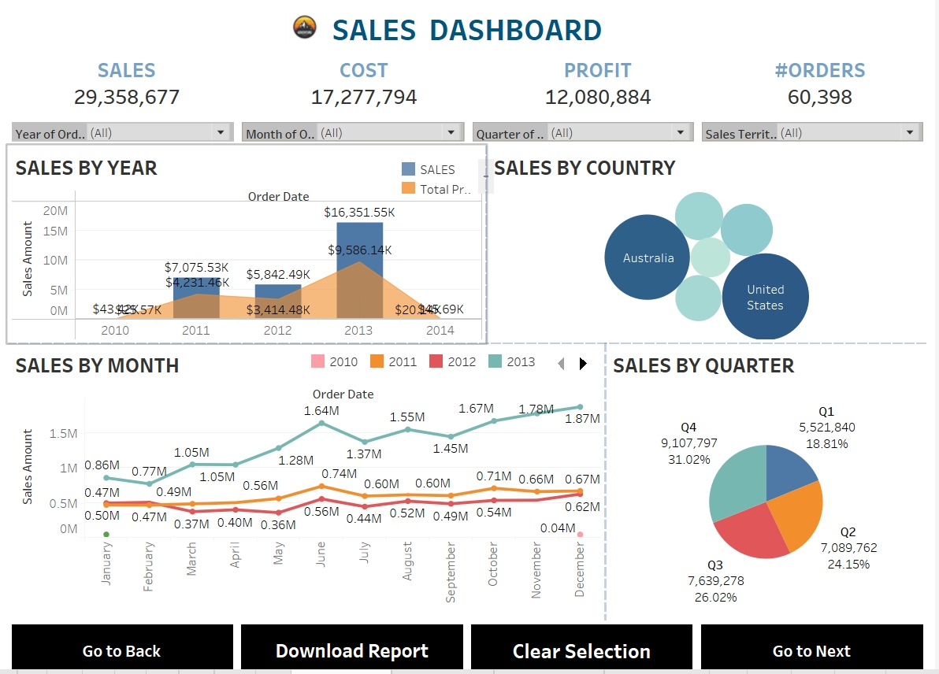

Slide 12
Dashboard Tableau data
Total Sales: The total sales amount is approximately $2.93 billion, with a total profit of $12.08 million and 60,398 orders.
Sales by Year: It shows sales distribution across different years, with the highest sales in 2013 and 2014.
Sales by Country: This section displays sales figures by country, with Australia and the United States being the top countries.
Sales by Month and Quarter: Sales are visualized by month, with the highest sales in Q2 and Q3. The dashboard allows for easy navigation and downloading of the report.

Slide 13
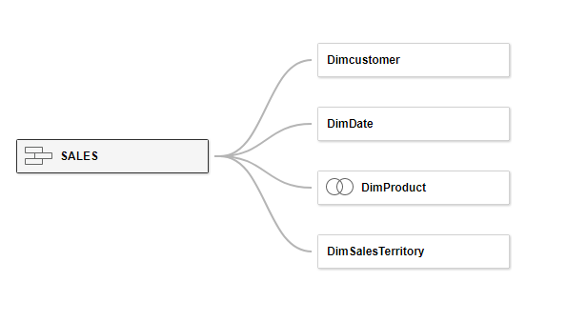
Tableau data

Slide 14
Difficulties faced while preparing Tableau
Dealing with data that doesn't fit neatly into standard relational database structures can be problematic.
Joining tables from different databases or data sources can be complicated and may require handling data type mismatches or performance issues.
Optimizing dashboard performance, especially with large datasets, can be a technical challenge. Techniques like data extracts, filters, and calculated fields may be necessary.
Documenting the design, logic, and best practices for your dashboard can be overlooked but is essential for future maintenance and collaboration.

Slide 15
Power Bi
This Power BI dashboard appears to present various sales-related metrics and data:
Total Sales: The dashboard displays a summary of total sales, the number of orders, and sales amount, with a focus on product cost.
Sales by Quarter: It visualizes sales performance over quarters, with the highest sales in Qtr 4, followed by Qtr 3 and Qtr 2.
Sales by Territory: The data may be segmented by different territories or regions, but specific details are not visible in this excerpt.
Profit by Quarter: The dashboard shows profitability by quarter, indicating a steady increase over time.
Percentage of Profit by Quarter: It highlights the percentage distribution of profit across different quarters.

Slide 16
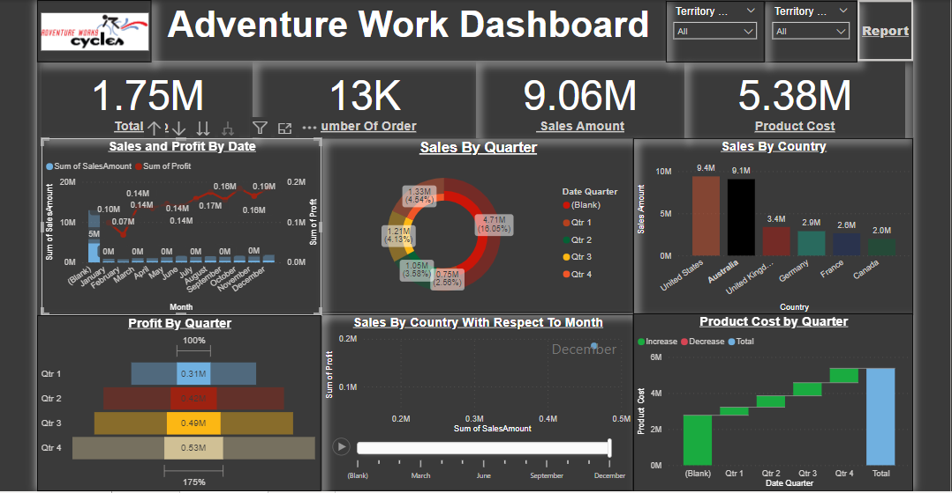

Slide 17
Difficulties faced in Power bi
Data may be scattered across various sources, contain missing values, duplicates, or inconsistencies. Transforming and shaping data into a usable format can be time-consuming.
Issues like data schema mismatches, key field conflicts, and different data structures can pose integration challenges.
Implementing complex calculations using the Data Analysis Expressions (DAX) language can be challenging, particularly for users who are new to DAX.
Deploying Power BI reports to production environments and sharing them with stakeholders can be challenging. Configuring data gateways, managing workspaces, and ensuring proper sharing and collaboration require careful planning.

Slide 18
SQL
This SQL query joins the "dimcustomer" and "internet sales" tables from the AdventureWorks database to display sales-related information. It calculates total sales amount, profit (sales amount minus total product cost), and cost for each customer, grouped by their names and gender. The data is ordered by the "Name" column in ascending order. This query is executed against external data in an Excel file named "Adventure Works_Fect_Internet_Sales_Nei". The results are visualized in a chart showing total sales and cost by customer name, with the chart configuration specified.
This SQL query extracts sales data from the "FactInternetSales" table in the AdventureWorks database. It calculates total sales by year, month, and quarter, using aggregation functions like SUM(). The results are grouped and ordered accordingly. Additionally, there's a query that calculates total sales by day. The data is organized and presented for analysis and visualization, with the option to save and explore the results.

Slide 19
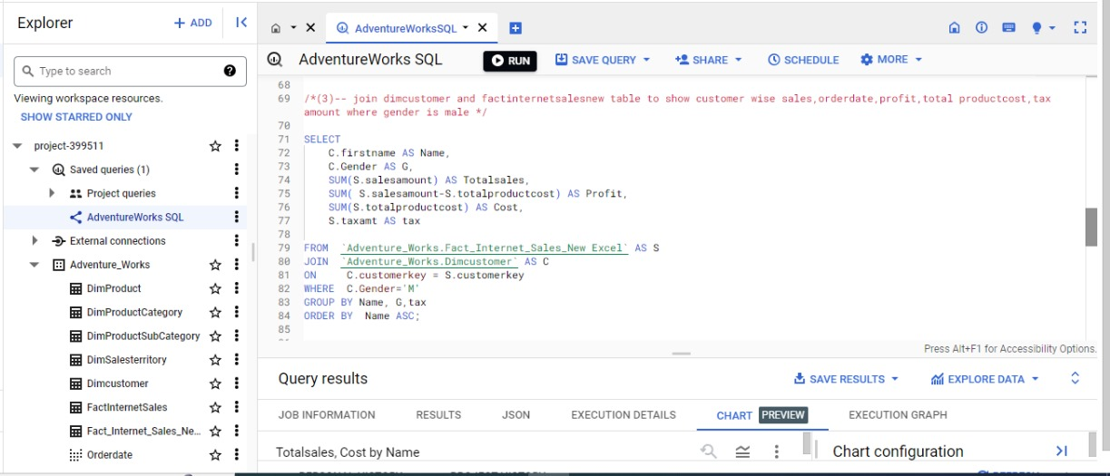
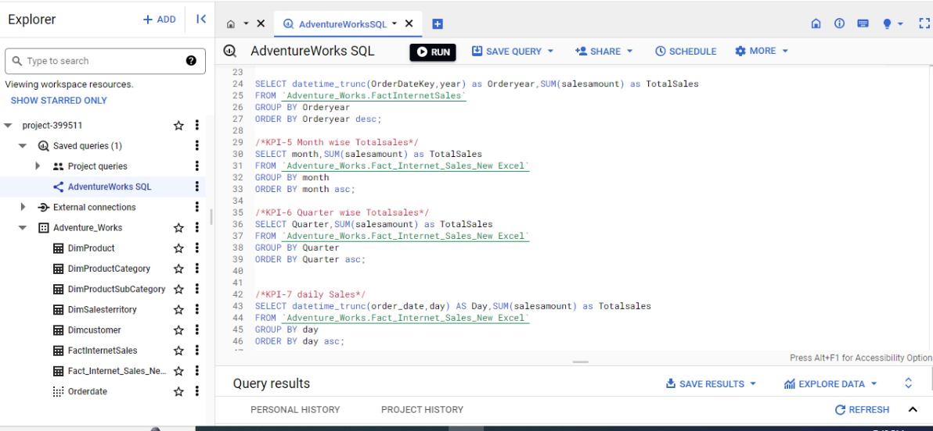

Slide 20
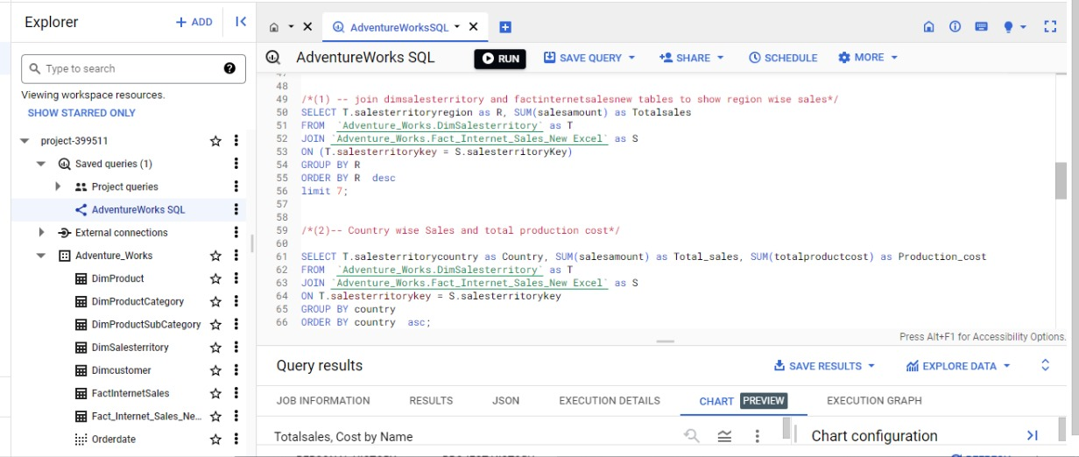
This SQL query combines data from the "dimSalesterritory" and "factInternetSalesNew" tables to analyze sales figures. It calculates region-wise total sales and groups them by sales territory region, ordered in descending order. Additionally, it computes country-wise total sales and total production cost, grouping by country and ordering them in ascending order. The results can be used for visualizations and further analysis.

Slide 21
The provided text appears to be a duplicate of the SQL query and related information previously described. It's a query joining the "dimcustomer" and "internet sales" tables from the Adventure Works database to show sales by customer, order date, profit, and total product cost. The results can be visualized and explored with chart configurations.

Slide 22
This SQL query combines data from the "dimproduct" and "factinternetsalesnew" tables to show the top 18 products in terms of sales, profit, and cost. It calculates the total sales, profit, and cost for each product, rounds the values, and orders the results in descending order by total sales. The query also includes product names and keys. In the results, Maurice M. Shan stands out as the top-selling product with $10,860.57 in total sales, generating a profit of $6,607.26.
This SQL query joins the "dimcustomer" and "internetsalesnew" tables to analyze the top 18 customers by sales and product cost. It calculates the total sales and product cost for each customer and groups them by name and gender. The results are sorted in descending order by total sales. Additionally, it creates a view named "Adventure_Works_Ordered_Sales" that includes various date-related columns. The query filters for orders with a quantity of 1 and provides insights into customer sales performance.

Slide 23
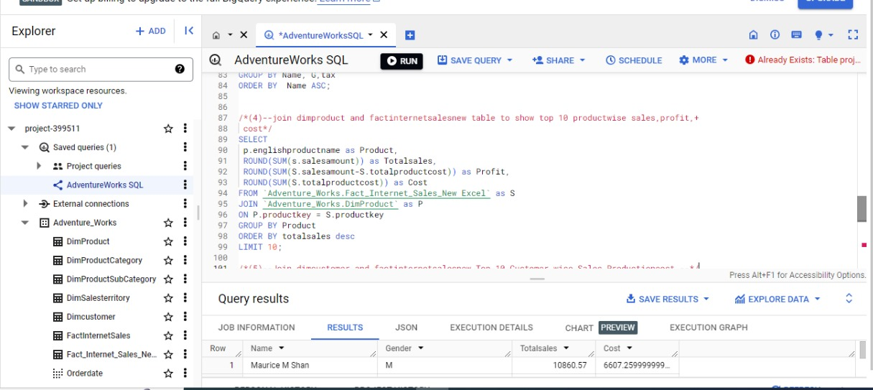
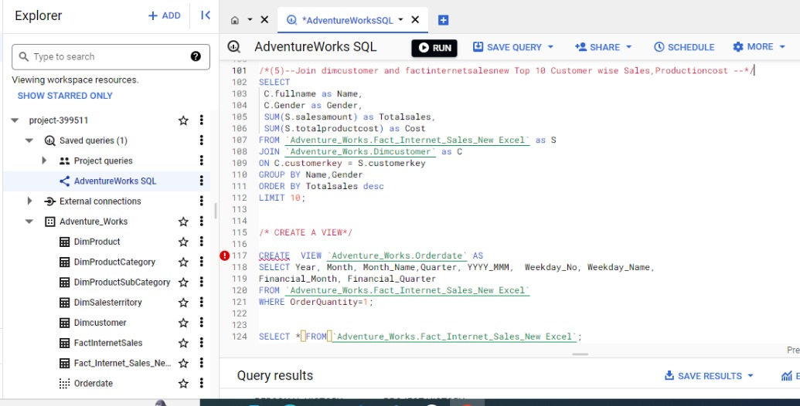

Slide 24
Difficulties faced
Uploading data to SQL
Manually create a main table and upload the data in the table
Joining issue in some queries
Converting column to date type

Slide 25
THANK YOU

